Slide 1


Team 54: ECEN215 Lab Kit 2
Bi-Weekly Update 2 Gavin Bernard
Maylun Huang
Evan Slyter
Sponsor: John Lusher TA: Hailey Ward
Notes:
Michelle

Slide 2
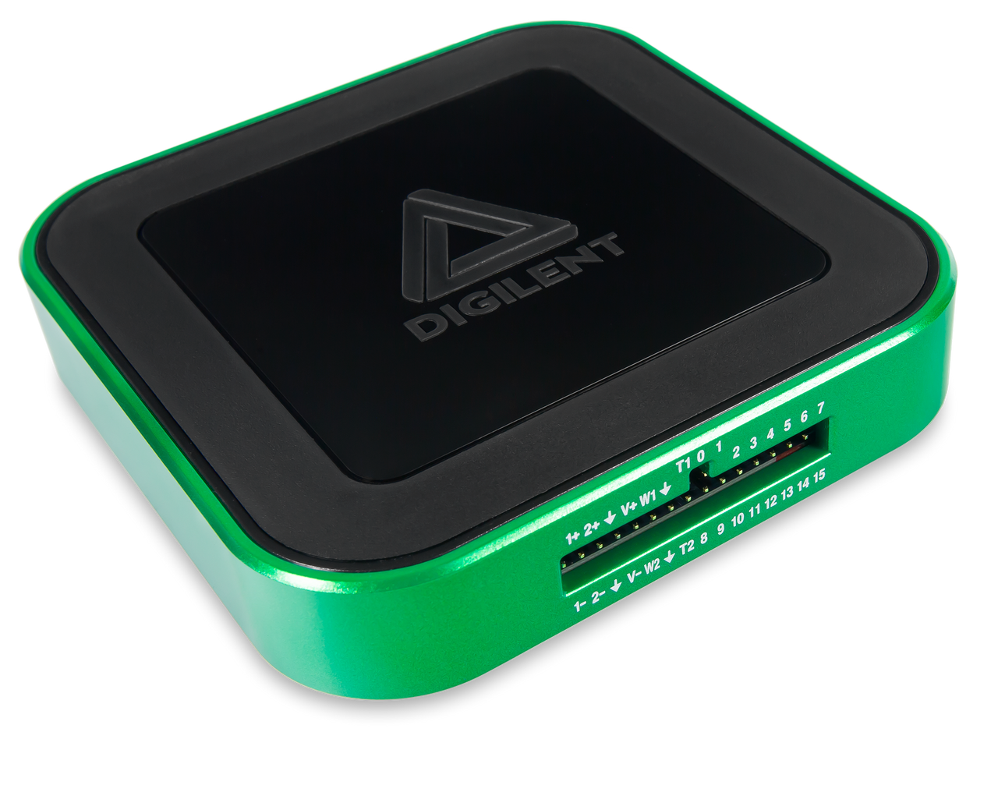
Project Summary
Problem statement:
Access to an affordable, course-specific solution for distance-learning students to complete ECEN215 Labs is minimal.
Our Solution:
An affordable, self-contained system that enables hands-on measurements and intuitive data displays.
Complete production of labkit for 50-75 dollars.
Easily transportable by hand.
AD3: $379
Notes:
Kyle

Slide 3
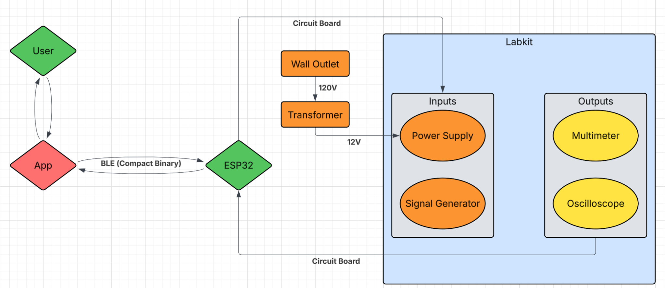
Project/System Overview
PCB
Software
Subsystem | Responsibility
Power Supply | Gavin Bernard
Signal Generator | Gavin Bernard
Mobile Application | Evan Slyter
Multimeter | Maylun Huang
Oscilloscope | Maylun Huang
Notes:
Eric

Slide 4
Project Timeline
1/26 | 2/9 | 2/23 | 3/16 | 3/30 | 4/20
Validate subsystems Phone-Phone BLE Validation | Finalize PCB & order | Soldered PCB App Integration | Integration Complete Fully Coded | Final Validation | Final Demo
Notes:
Eric

Slide 5
Power Supply/Signal Generator
Gavin Bernard
Accomplishments since last update 20 hrs of effort | Ongoing progress/problems and plans until the next presentation
Verification of both subsystems Created PCB for ongoing integration with oscillator and multimeter | Integrate PCB and Order Solder and code over Design Blitz

Slide 6
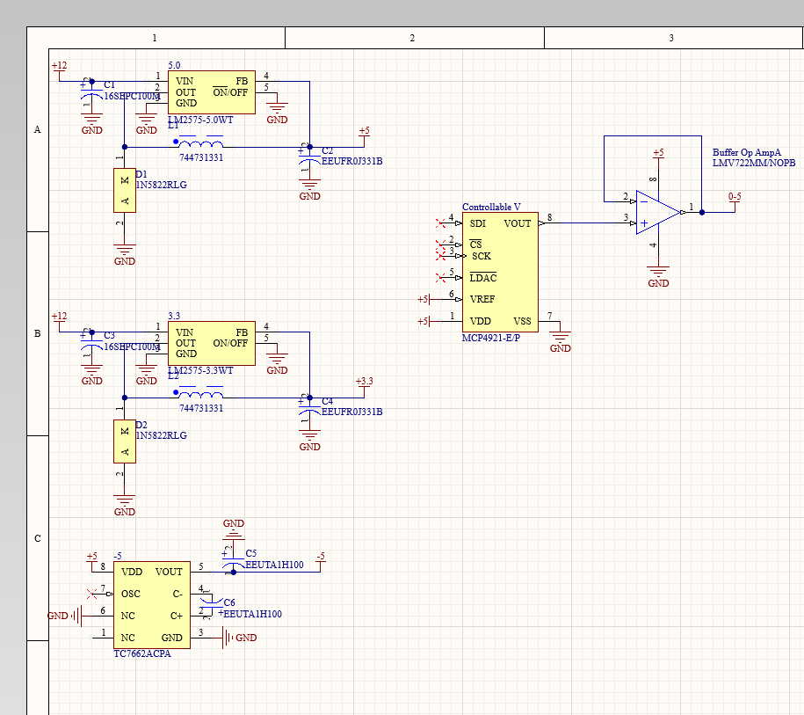
Power Supply/Signal Generator
Gavin Bernard

Slide 7
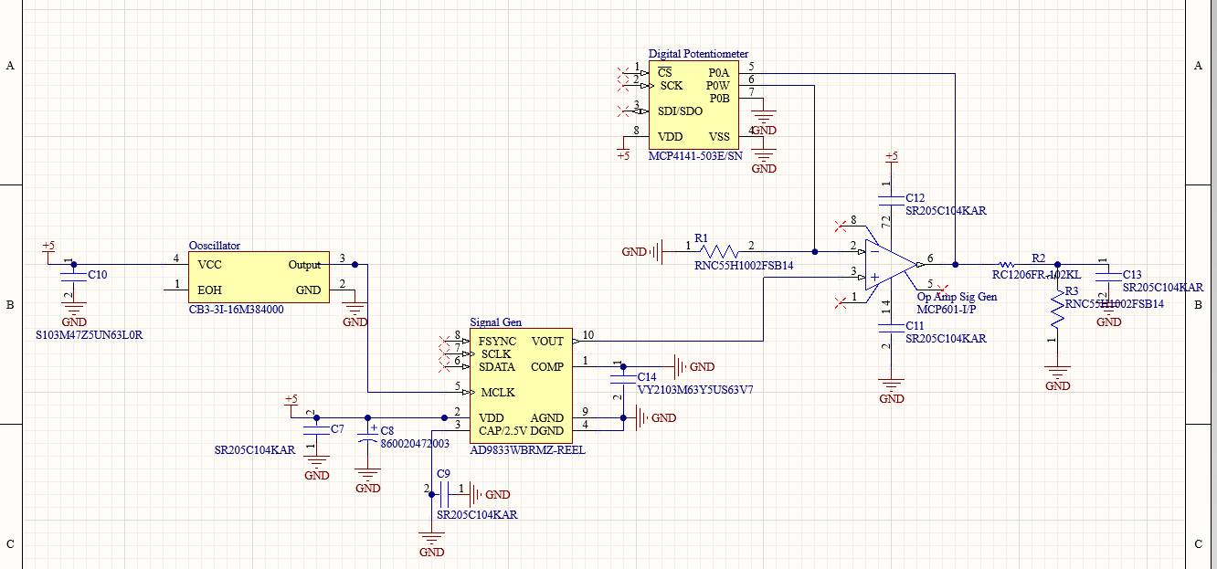
Power Supply/Signal Generator
Gavin Bernard

Slide 8
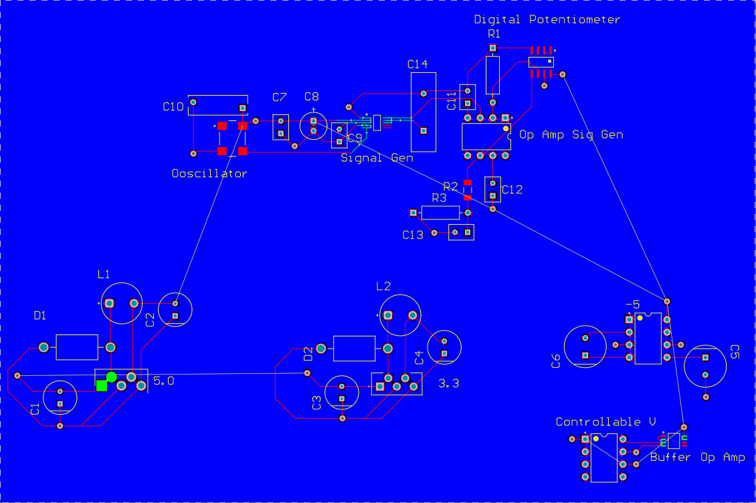
Power Supply/Signal Generator
Gavin Bernard

Slide 9
Measurement Subsystem
Maylun Huang
Accomplishments since last update 12 hrs of effort | Ongoing progress/problems and plans until the next presentation
Subsystem validation Multimeter adjustments to improve cost & space | Integrate PCB & order

Slide 10
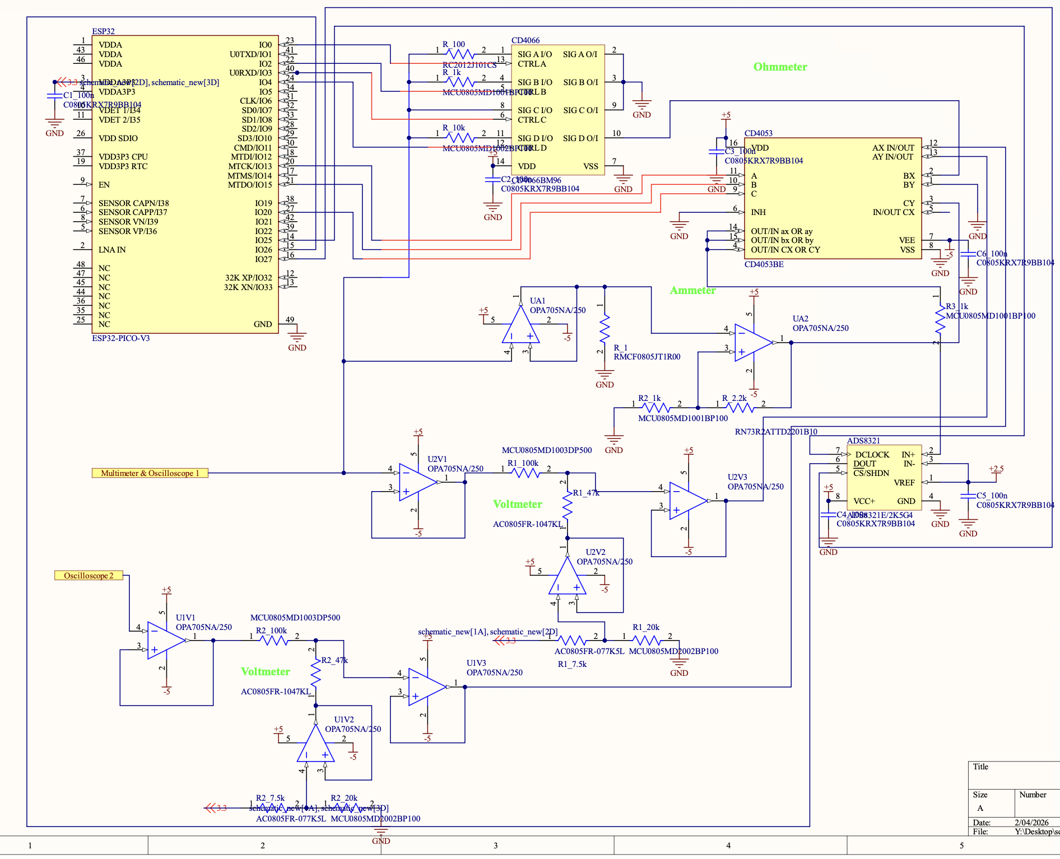
Measurement Subsystem
Maylun Huang
Switched out op-amp ($3.22 → $1.68 ea.)
Removed 2 op-amp buffers
Combined multimeter inputs
Improved ohmmeter range from 100-~8.5kΩ to 47-10kΩ+
PCB wiring in progress

Slide 11
Mobile App
Evan Slyter
Accomplishments since last update 8 hrs of effort | Ongoing progress/problems and plans until the next presentation
-Successfully connected to BLE emitter in preparation for connecting to MCU | -Begin writing code to be used on MCU once it arrives

Slide 12
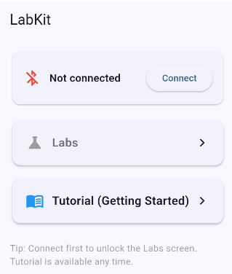
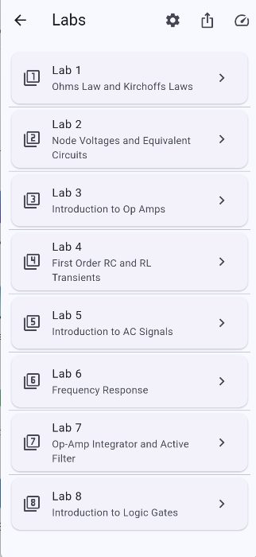
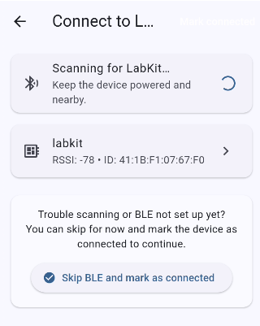
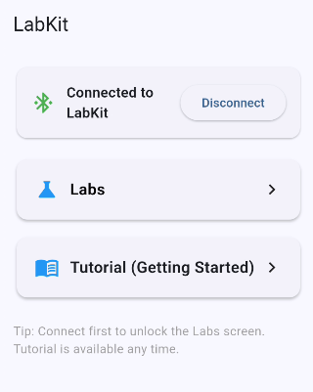
Mobile App
Evan Slyter
-Many security issues to get the app to accept a connection
-Currently connecting app to phone instead of app to MCU

Slide 13
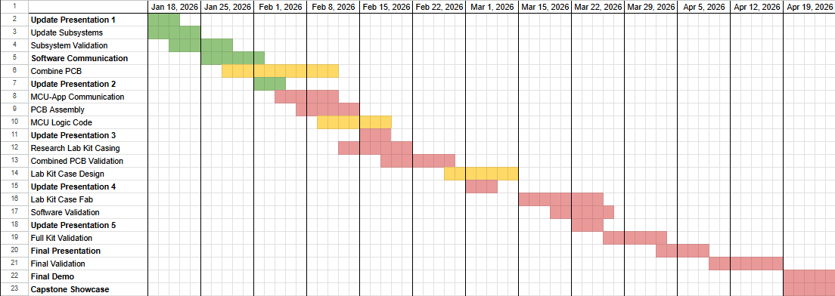
Execution Plan
Notes:
Michelle

Slide 14
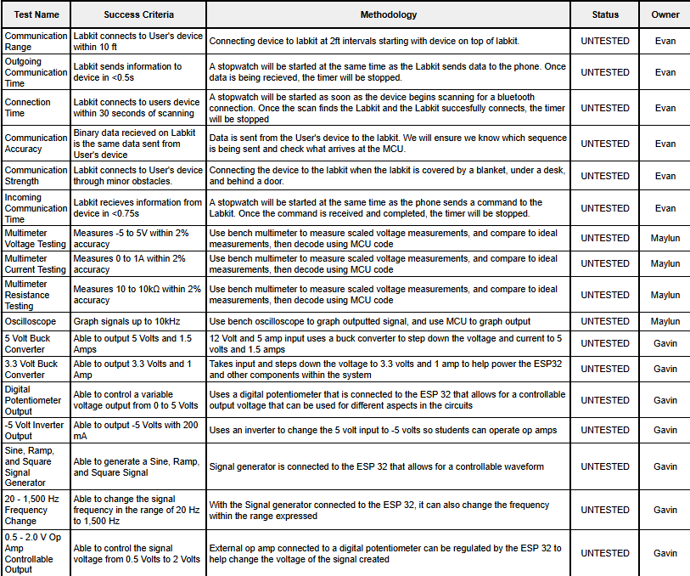
Validation Plan
Notes:
Michelle

Slide 15
Final slide – thank your audience

